Slide 1
Roach Pass Splitting
Jonah Lee

Slide 2
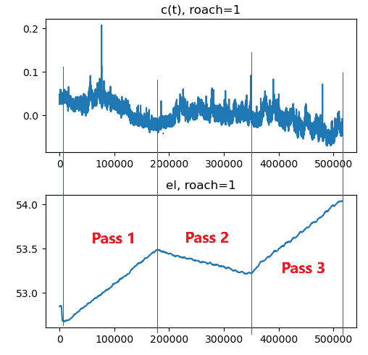
Why Split up Passes?
3 scans of RCW-92, ~6 min each
Common-mode signal trends with time
By splitting the maps into 3-passes, we can reduce the trending of the common-mode
Bad data/KIDs may have messed up one of the passes, but others may still be good
Could lead to interesting time-domain information (we are effectively taking 3 sequential pictures)

Slide 3
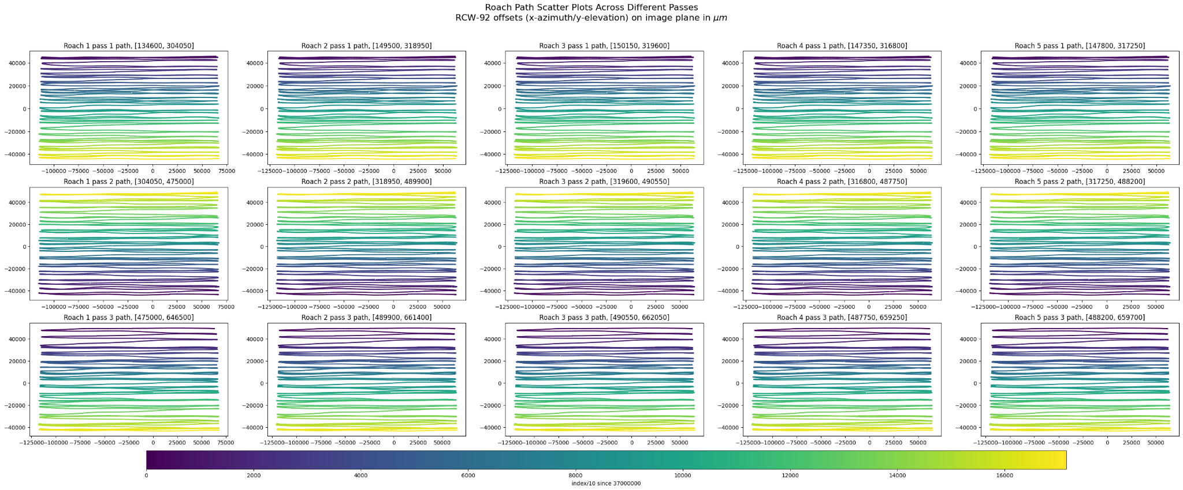
Finding Indices: 5 Roaches x 3 Passes
Notes:
In order to determine all indices, it suffices to determine the starting index for each roach and then the length of each pass. Then, these can be manipulated in order to determine the start and end of each pass. This is possible because all roach arrays have the same spacing (period) in time.
In theory, we can build maps from any combination of each of these 15 frames.

Slide 4
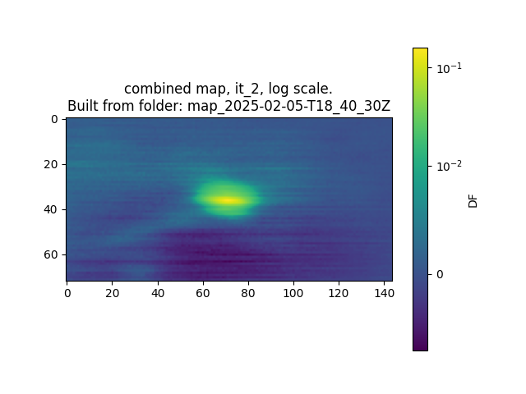
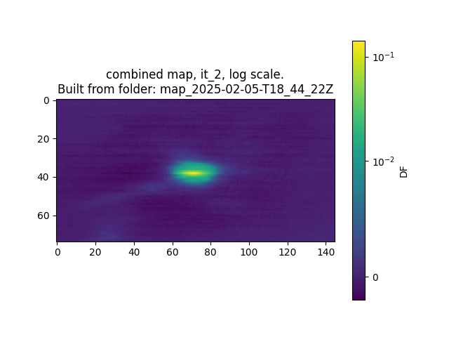
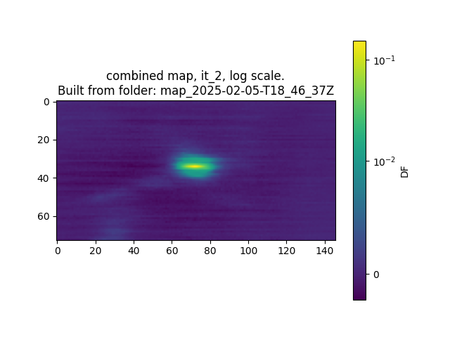
Results, Roach 1:
Left to right: pass 1, pass 2, pass 3

Slide 5
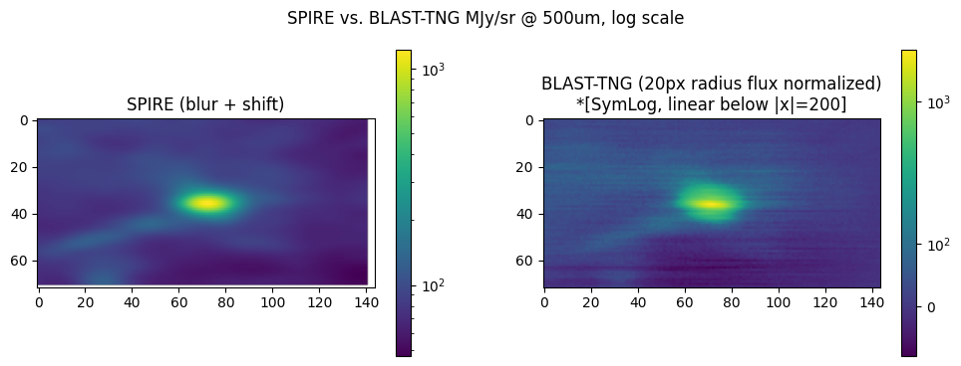
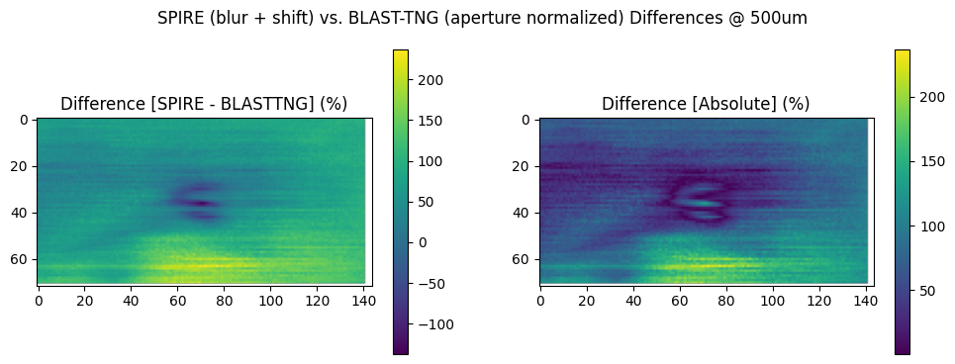
SPIRE Image Difference - 1st Pass
OLD - STDDEV

Slide 6
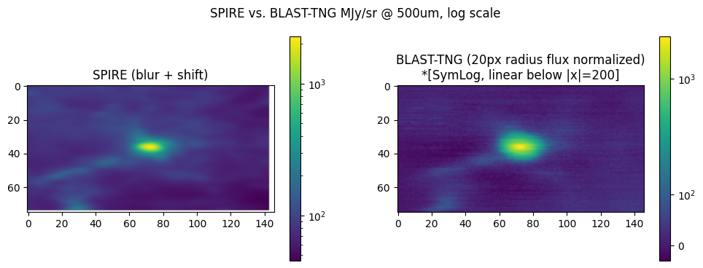
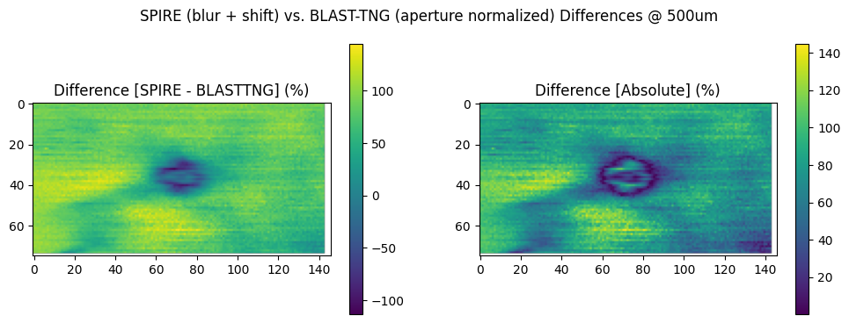
SPIRE Image Difference - 2nd Pass
OLD - STDDEV

